Slide 1

Linear Predictive Analysis of Speech Signals

Slide 2
Contents
Basic Principles of Linear Predictive Analysis
Computation of the Gain of the Model
Frequency Domain Interpretations
The Prediction Error Signal
Relation of LPA to Lossless Tube Models

Slide 3
Basic Principles of Linear Predictive Analysis

Slide 4
Basic Principles of Linear Predictive Analysis
Why Linear Predictive Analysis?
Speech Signal Analysis
Used extensively in speech processing for applications like speech synthesis and coding.
Compact Representation
LPA provides a compact model of vocal tract characteristics.

Slide 5
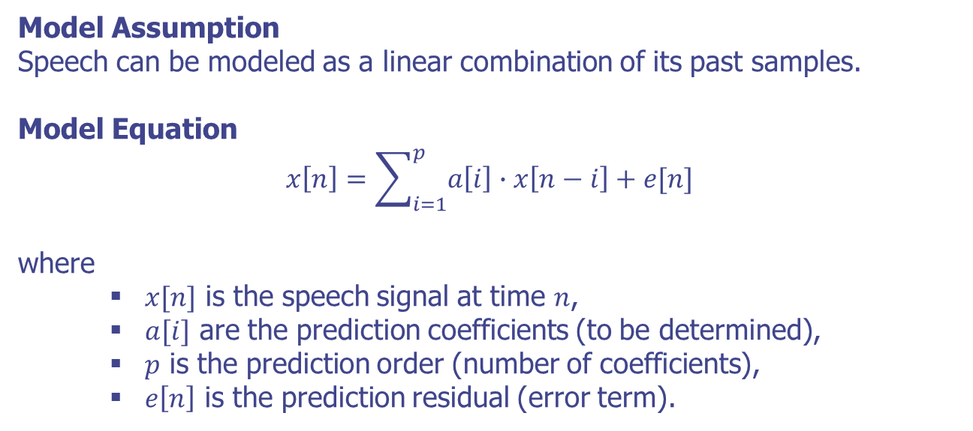
Basic Principles of Linear Predictive Analysis
Formulation of Linear Prediction
Model Assumption
Speech can be modeled as a linear combination of its past samples.
Model Equation
$$x\left[n\right]=\sum_{i=1}^{p}{a\left[i\right]∙x\left[n−i\right]+e[n]}$$
where
$x[n]$ is the speech signal at time $n$,
$a[i]$ are the prediction coefficients (to be determined),
$p$ is the prediction order (number of coefficients),
$e\left[n\right]$ is the prediction residual (error term).

Slide 6
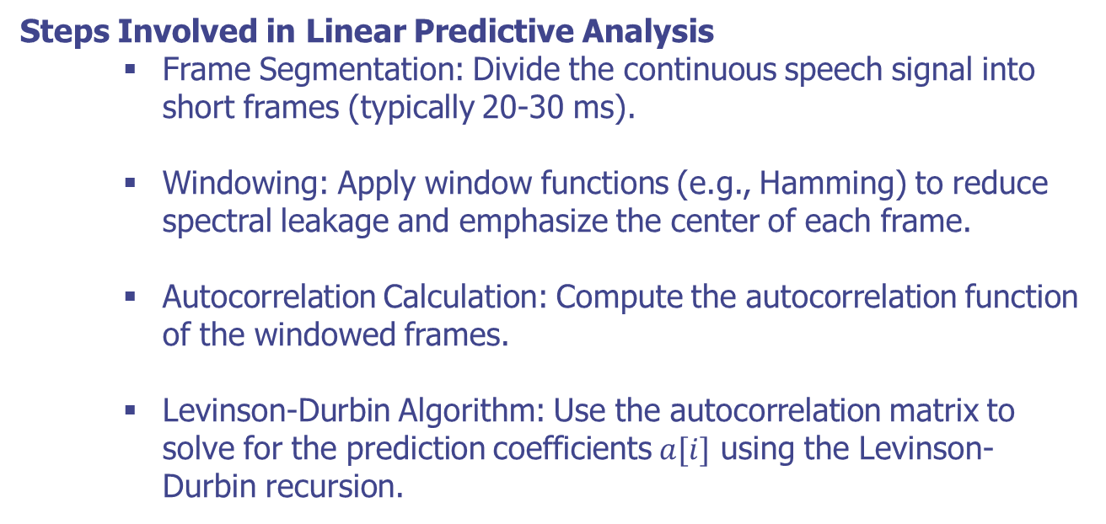
Basic Principles of Linear Predictive Analysis
Key Steps in LPA
Steps Involved in Linear Predictive Analysis
Frame Segmentation: Divide the continuous speech signal into short frames (typically 20-30 ms).
Windowing: Apply window functions (e.g., Hamming) to reduce spectral leakage and emphasize the center of each frame.
Autocorrelation Calculation: Compute the autocorrelation function of the windowed frames.
Levinson-Durbin Algorithm: Use the autocorrelation matrix to solve for the prediction coefficients $a[i]$ using the Levinson-Durbin recursion.

Slide 7
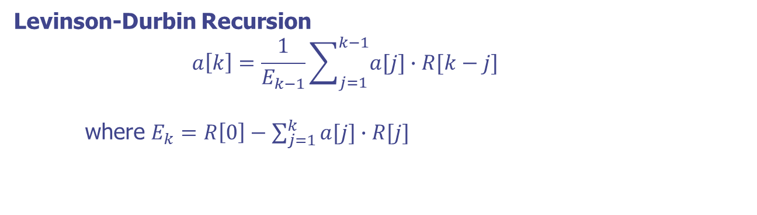

Basic Principles of Linear Predictive Analysis
Autocorrelation and Levinson-Durbin Algorithm
Autocorrelation Matrix
$$R\left[k\right]=\sum_{n=0}^{N−1}{x[n]∙x[n−k]}$$
Where $N$ is the frame length and $k$ is the lag
Levinson-Durbin Recursion
$$a\left[k\right]=\frac{1}{E_{k−1}}\sum_{j=1}^{k−1}{a[j]∙R[k−j]}$$
where $E_{k}=R\left[0\right]−\sum_{j=1}^{k}{a[j]∙R[j]}$

Slide 8
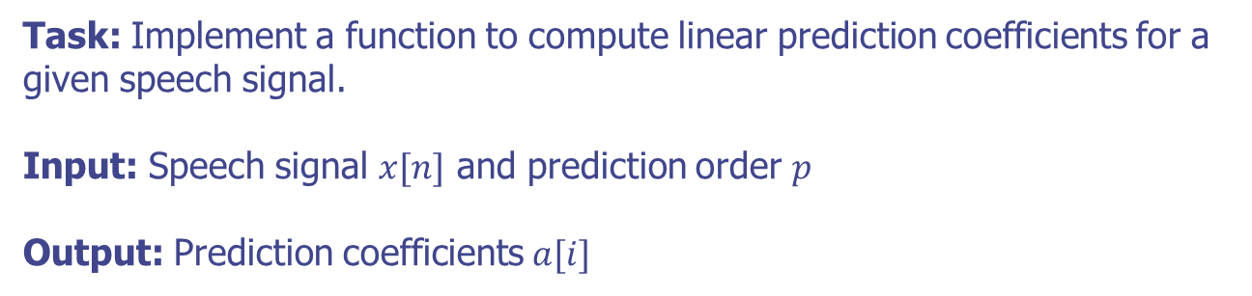
Basic Principles of Linear Predictive Analysis
Practical Assignment
Task: Implement a function to compute linear prediction coefficients for a given speech signal.
Input: Speech signal $x[n]$ and prediction order $p$
Output: Prediction coefficients $a[i]$

Slide 9
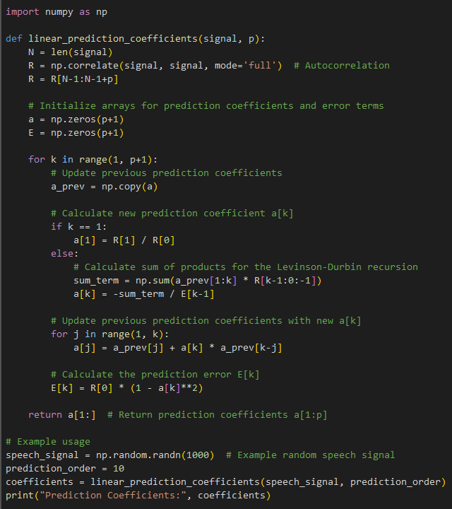
Basic Principles of Linear Predictive Analysis
Practical Assignment

Slide 10
Basic Principles of Linear Predictive Analysis
Summary
Linear Predictive Analysis is essential for modeling speech signals by predicting future samples based on past information.
The Levinson-Durbin recursion efficiently computes the prediction coefficients using the autocorrelation function.
Python provides useful tools (e.g., NumPy) for implementing and experimenting with LPA techniques.

Slide 11
Computation of the Gain of the Model

Slide 12
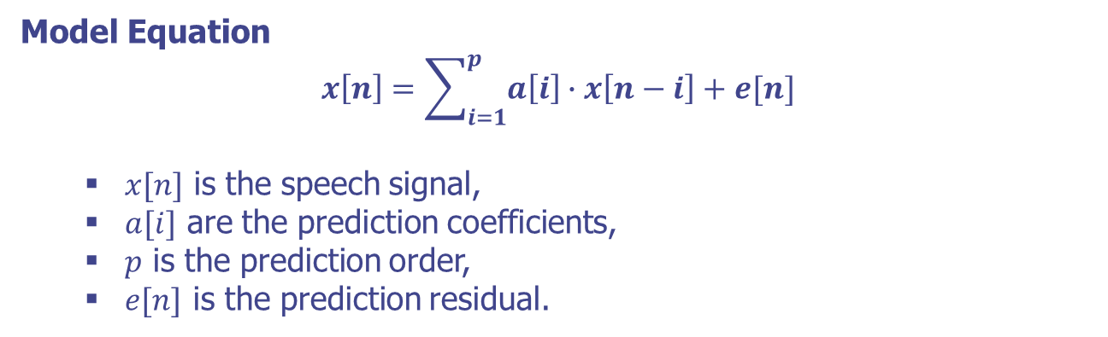
Computation of the Gain of the Model
Calculation of Model Gain
Model Equation
$$x\left[n\right]=\sum_{i=1}^{p}{a\left[i\right]∙x\left[n−i\right]+e[n]}$$
$x[n]$ is the speech signal,
$a[i]$ are the prediction coefficients,
$p$ is the prediction order,
$e[n]$ is the prediction residual.

Slide 13
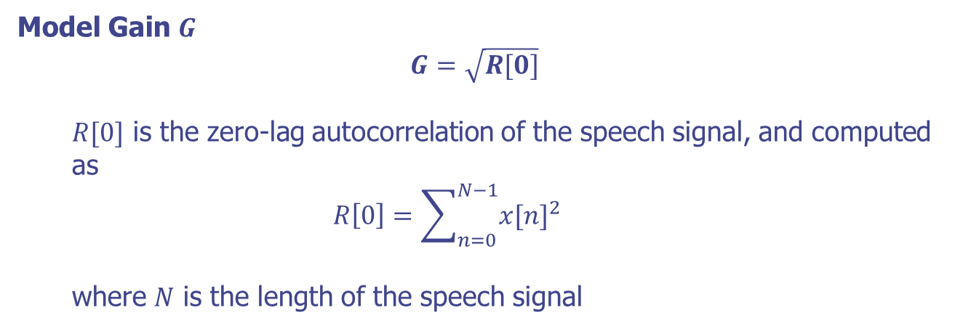
Computation of the Gain of the Model
Calculation of Model Gain
Model Gain $G$
$$G=\sqrt{R[0]}$$
$R[0]$ is the zero-lag autocorrelation of the speech signal, and computed as
$$R\left[0\right]=\sum_{n=0}^{N−1}{x{[n]}^{2}}$$
where $N$ is the length of the speech signal

Slide 14
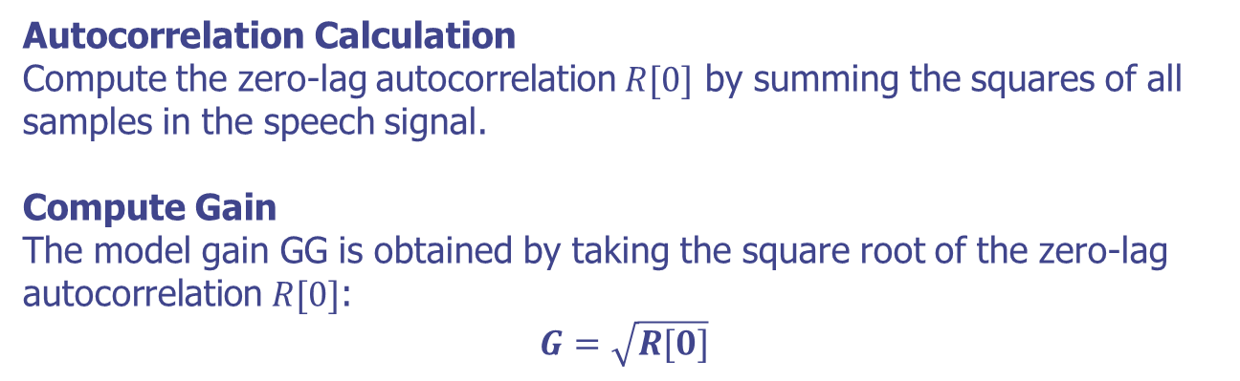
Computation of the Gain of the Model
Steps to Compute Model Gain
Autocorrelation Calculation
Compute the zero-lag autocorrelation $R[0]$ by summing the squares of all samples in the speech signal.
Compute Gain
The model gain GG is obtained by taking the square root of the zero-lag autocorrelation $R[0]$:
$$G=\sqrt{R[0]}$$

Slide 15
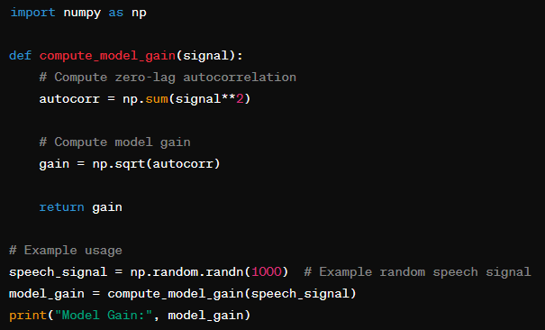
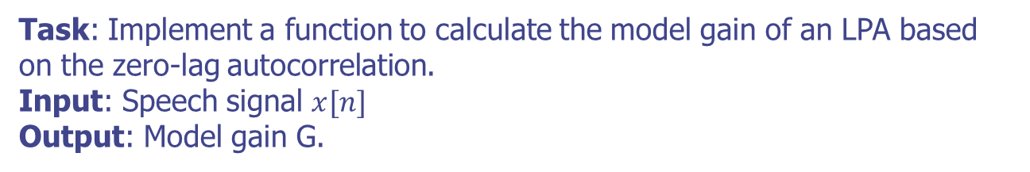
Computation of the Gain of the Model
Practical Assignment
Task: Implement a function to calculate the model gain of an LPA based on the zero-lag autocorrelation.
Input: Speech signal $x[n]$
Output: Model gain G.

Slide 16
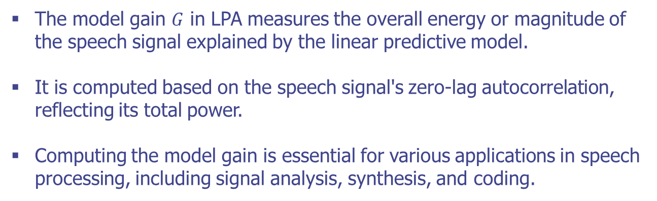
Computation of the Gain of the Model
Summary
The model gain $G$ in LPA measures the overall energy or magnitude of the speech signal explained by the linear predictive model.
It is computed based on the speech signal's zero-lag autocorrelation, reflecting its total power.
Computing the model gain is essential for various applications in speech processing, including signal analysis, synthesis, and coding.

Slide 17
Frequency Domain Interpretations

Slide 18
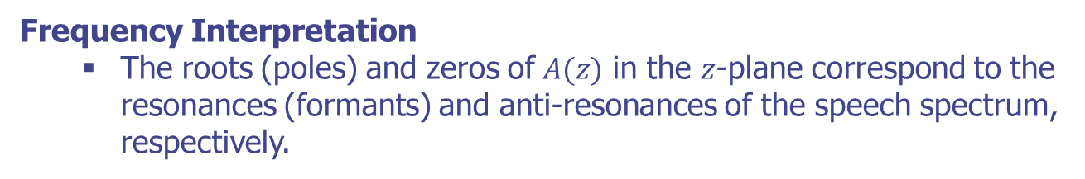
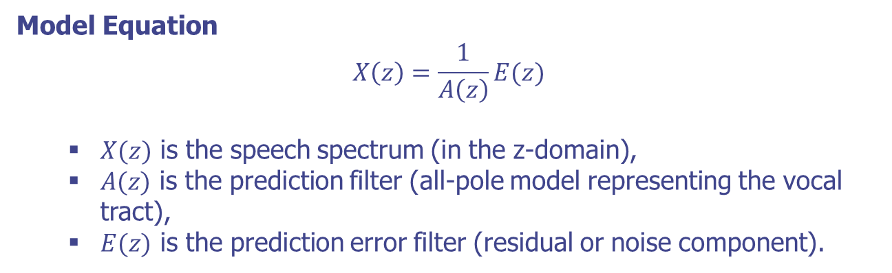
Frequency Domain Interpretations
Frequency Domain Formulation
Model Equation
$$X\left(z\right)=\frac{1}{A\left(z\right)}E(z)$$
$X(z)$ is the speech spectrum (in the z-domain),
$A(z)$ is the prediction filter (all-pole model representing the vocal tract),
$E(z)$ is the prediction error filter (residual or noise component).
Frequency Interpretation
The roots (poles) and zeros of$A(z)$ in the $z$-plane correspond to the resonances (formants) and anti-resonances of the speech spectrum, respectively.

Slide 19
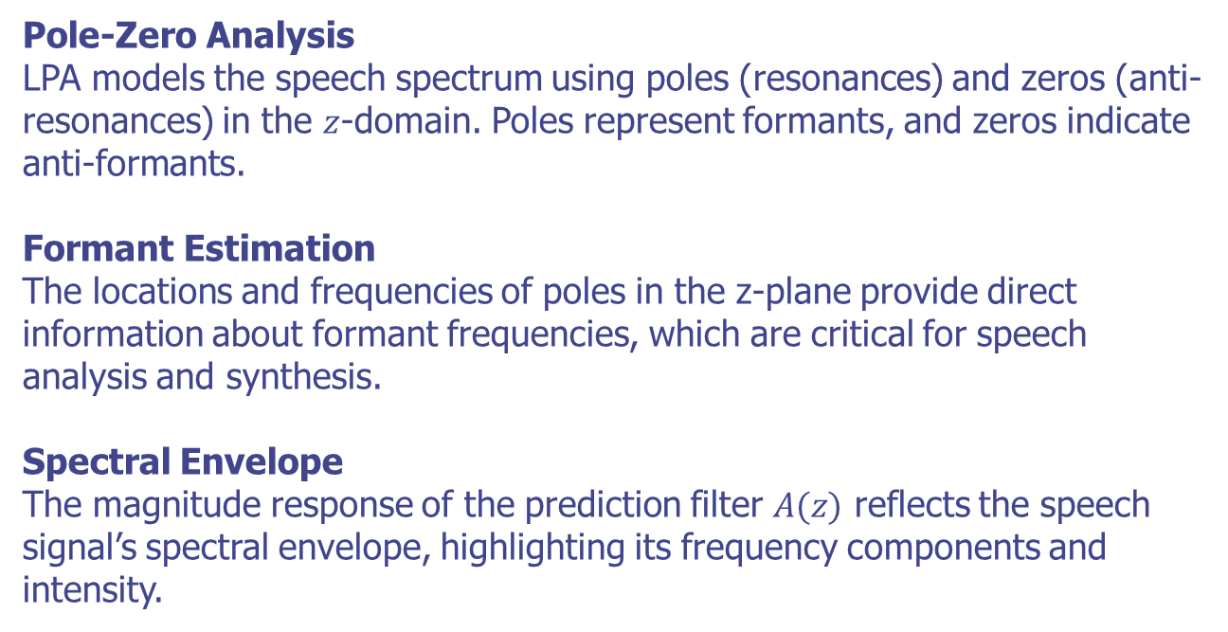
Frequency Domain Interpretations
Components of Frequency Domain Analysis
Pole-Zero Analysis
LPA models the speech spectrum using poles (resonances) and zeros (anti-resonances) in the $z$-domain. Poles represent formants, and zeros indicate anti-formants.
Formant Estimation
The locations and frequencies of poles in the z-plane provide direct information about formant frequencies, which are critical for speech analysis and synthesis.
Spectral Envelope
The magnitude response of the prediction filter $A(z)$ reflects the speech signal’s spectral envelope, highlighting its frequency components and intensity.

Slide 20
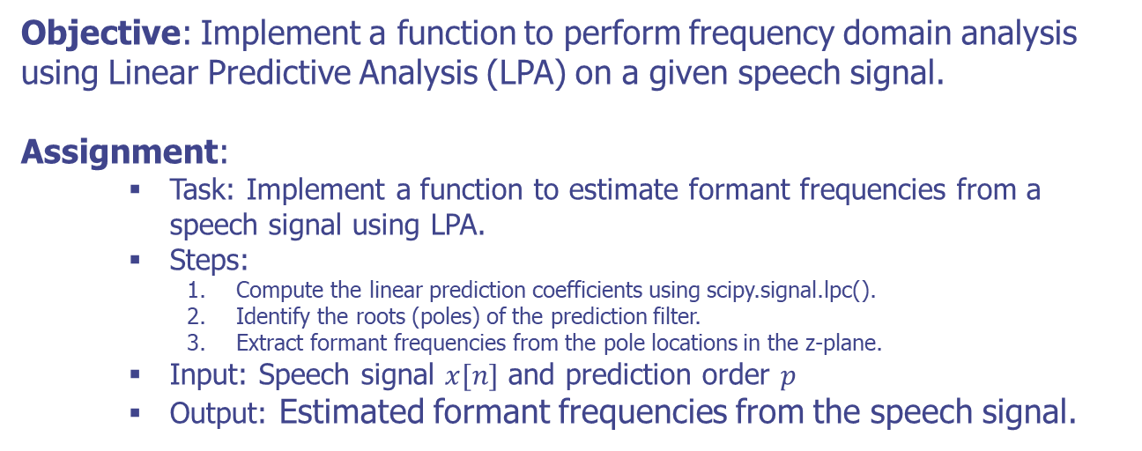
Frequency Domain Interpretations
Practical Assignment
Objective: Implement a function to perform frequency domain analysis using Linear Predictive Analysis (LPA) on a given speech signal.
Assignment:
Task: Implement a function to estimate formant frequencies from a speech signal using LPA.
Steps:
Compute the linear prediction coefficients using scipy.signal.lpc().
Identify the roots (poles) of the prediction filter.
Extract formant frequencies from the pole locations in the z-plane.
Input: Speech signal $x[n]$ and prediction order $p$
Output: Estimated formant frequencies from the speech signal.

Slide 21
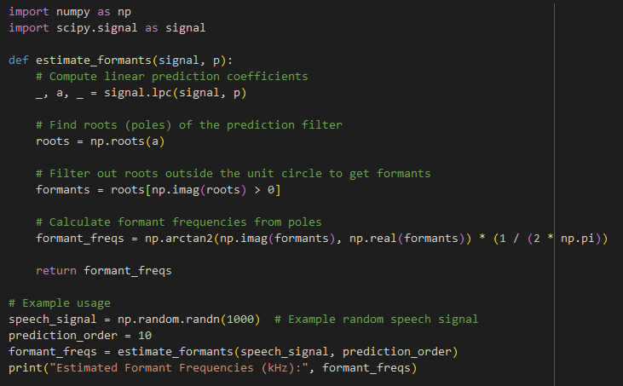
Frequency Domain Interpretations
Practical Assignment

Slide 22
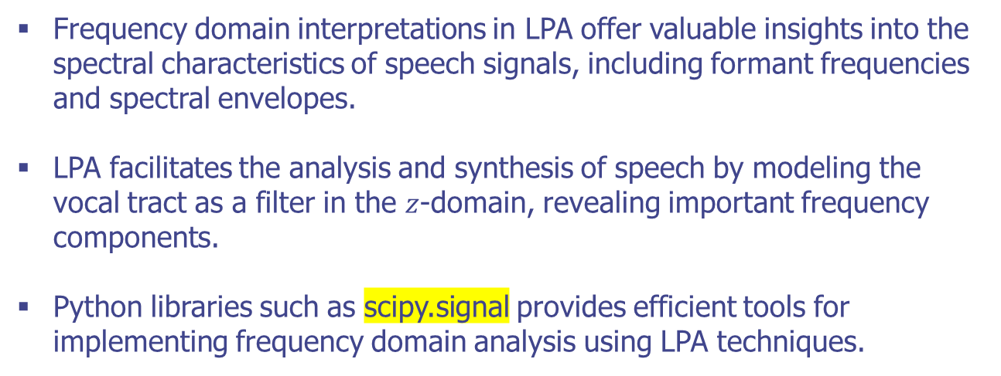
Frequency Domain Interpretations
Summary
Frequency domain interpretations in LPA offer valuable insights into the spectral characteristics of speech signals, including formant frequencies and spectral envelopes.
LPA facilitates the analysis and synthesis of speech by modeling the vocal tract as a filter in the $z$-domain, revealing important frequency components.
Python libraries such as scipy.signal provides efficient tools for implementing frequency domain analysis using LPA techniques.

Slide 23
The Prediction Error Signal

Slide 24
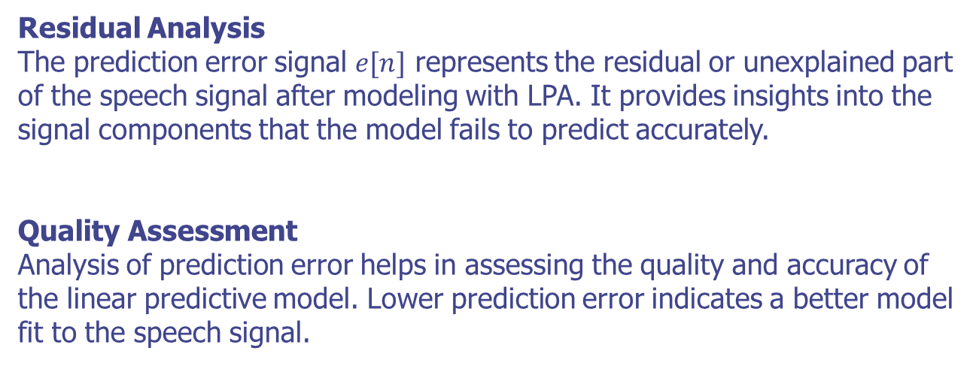
The Prediction Error Signal
Introduction
Residual Analysis
The prediction error signal $e[n]$ represents the residual or unexplained part of the speech signal after modeling with LPA. It provides insights into the signal components that the model fails to predict accurately.
Quality Assessment
Analysis of prediction error helps in assessing the quality and accuracy of the linear predictive model. Lower prediction error indicates a better model fit to the speech signal.

Slide 25
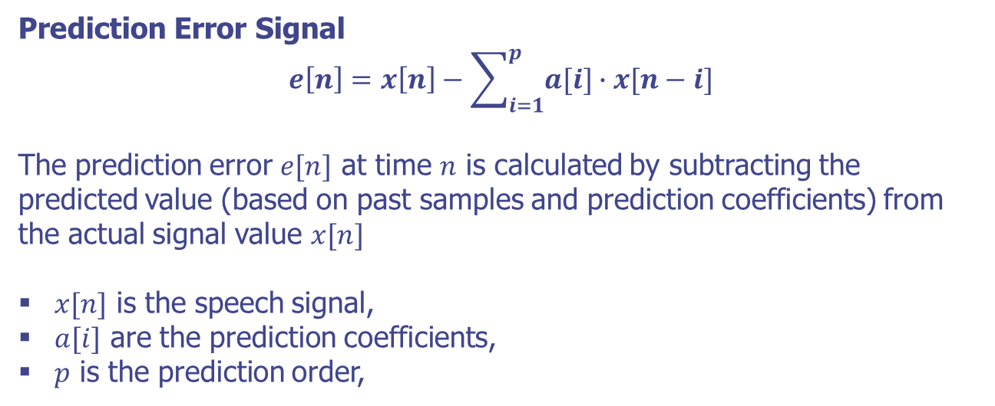
The Prediction Error Signal
Formulation
Prediction Error Signal
$$e\left[n\right]=x\left[n\right]−\sum_{i=1}^{p}{a[i]∙x[n−i]}$$
The prediction error $e[n]$ at time $n$ is calculated by subtracting the predicted value (based on past samples and prediction coefficients) from the actual signal value $x[n]$
$x[n]$ is the speech signal,
$a[i]$ are the prediction coefficients,
$p$ is the prediction order,

Slide 26
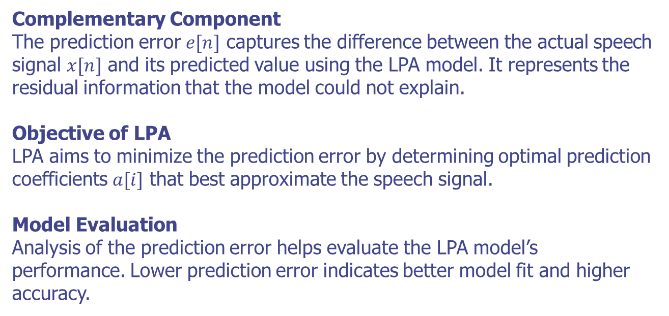
The Prediction Error Signal
Key Concepts of Prediction Error
Complementary Component
The prediction error $e[n]$ captures the difference between the actual speech signal $x[n]$ and its predicted value using the LPA model. It represents the residual information that the model could not explain.
Objective of LPA
LPA aims to minimize the prediction error by determining optimal prediction coefficients $a[i]$ that best approximate the speech signal.
Model Evaluation
Analysis of the prediction error helps evaluate the LPA model’s performance. Lower prediction error indicates better model fit and higher accuracy.

Slide 27
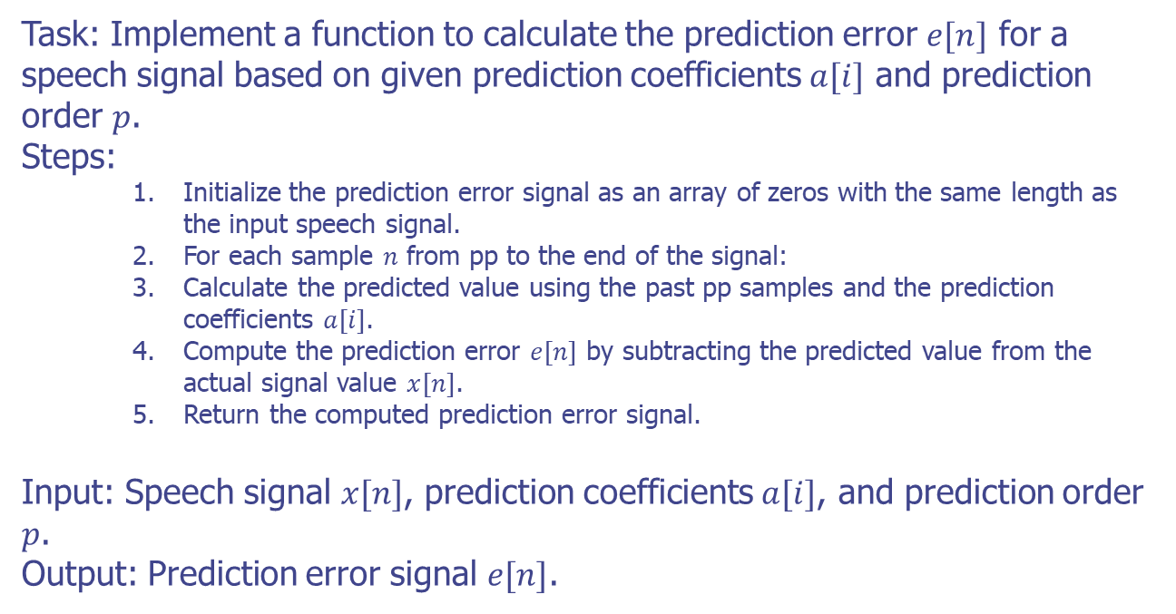
The Prediction Error Signal
Practical Assignment
Task: Implement a function to calculate the prediction error $e[n]$ for a speech signal based on given prediction coefficients $a[i]$ and prediction order $p$.
Steps:
Initialize the prediction error signal as an array of zeros with the same length as the input speech signal.
For each sample $n$ from pp to the end of the signal:
Calculate the predicted value using the past pp samples and the prediction coefficients $a[i]$.
Compute the prediction error $e[n]$ by subtracting the predicted value from the actual signal value $x[n]$.
Return the computed prediction error signal.
Input: Speech signal $x[n]$, prediction coefficients $a[i]$, and prediction order $p$.
Output: Prediction error signal $e[n]$.

Slide 28
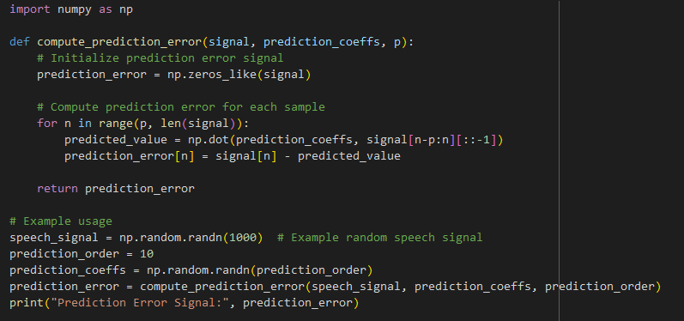
The Prediction Error Signal
Practical Assignment

Slide 29
Relation of LPA to Lossless Tube Models

Slide 30
Relation of LPA to Lossless Tube Models
Overview of Lossless Tube Models
Model Description
Acoustic tube models represent the vocal tract as a series of cylindrical tubes with specific length, diameter, and boundary conditions.
These models assume no energy loss within the tubes (lossless) and describe wave propagation and reflections along the vocal tract.
Key Elements
Length and Diameter: Parameters of the tubes that affect resonance frequencies.
Boundary Conditions: Influence the behavior of waves within the tube (open or closed ends), affecting resonant frequencies.

Slide 31
Relation of LPA to Lossless Tube Models
Formulation of LPA and Acoustic Tube Models
Connection between LPA and Tube Models
Linear Predictive Analysis (LPA)
LPA models the vocal tract using a linear filter (all-pole model) to predict speech signals based on past samples.
The prediction coefficients in LPA correspond to resonances (formants) in speech.
Relation to Tube Models
The prediction coefficients in LPA can be related to the acoustic properties (resonances) of an equivalent lossless tube model.
Both LPA and tube models aim to characterize the spectral properties of speech signals by identifying resonant frequencies.

Slide 32
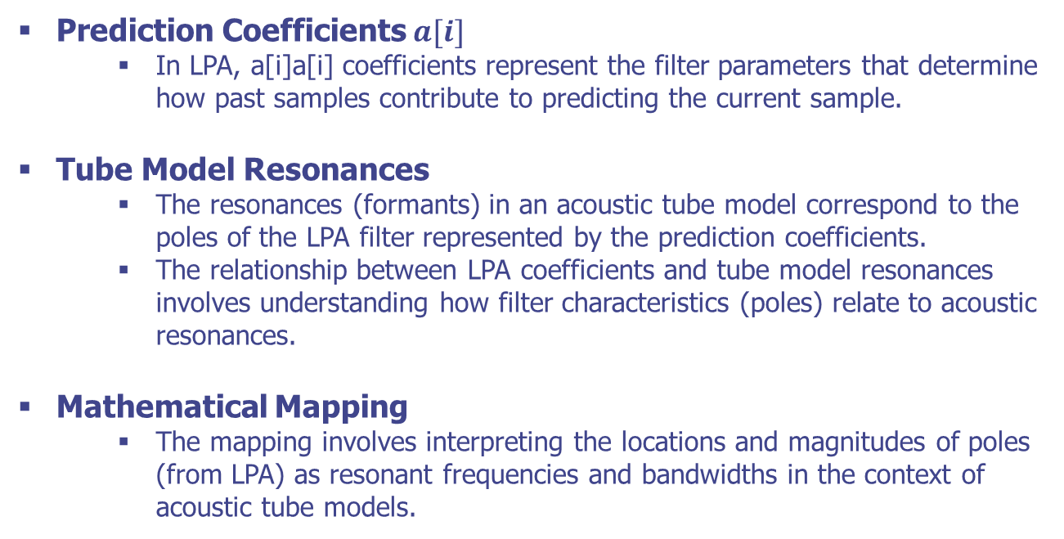
Relation of LPA to Lossless Tube Models
Mapping LPA to Tube Model Parameters
Prediction Coefficients $a[i]$
In LPA, a[i]a[i] coefficients represent the filter parameters that determine how past samples contribute to predicting the current sample.
Tube Model Resonances
The resonances (formants) in an acoustic tube model correspond to the poles of the LPA filter represented by the prediction coefficients.
The relationship between LPA coefficients and tube model resonances involves understanding how filter characteristics (poles) relate to acoustic resonances.
Mathematical Mapping
The mapping involves interpreting the locations and magnitudes of poles (from LPA) as resonant frequencies and bandwidths in the context of acoustic tube models.

Slide 33
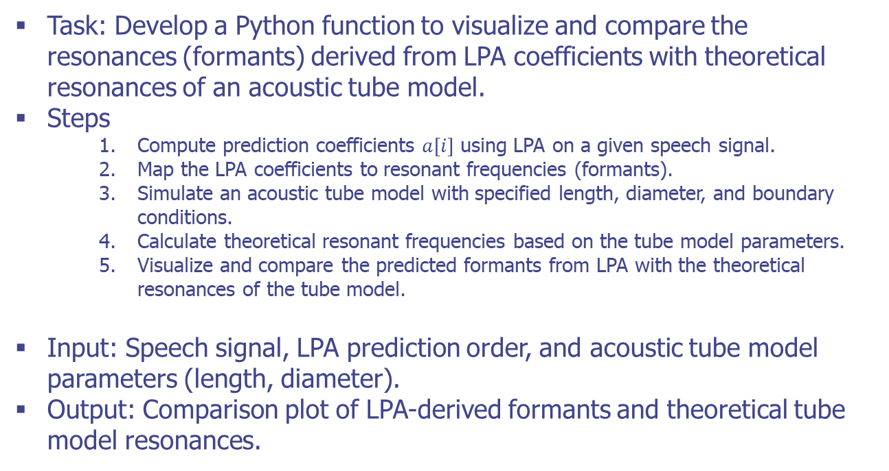
Relation of LPA to Lossless Tube Models
Practical Assignment
Task: Develop a Python function to visualize and compare the resonances (formants) derived from LPA coefficients with theoretical resonances of an acoustic tube model.
Steps
Compute prediction coefficients $a[i]$ using LPA on a given speech signal.
Map the LPA coefficients to resonant frequencies (formants).
Simulate an acoustic tube model with specified length, diameter, and boundary conditions.
Calculate theoretical resonant frequencies based on the tube model parameters.
Visualize and compare the predicted formants from LPA with the theoretical resonances of the tube model.
Input: Speech signal, LPA prediction order, and acoustic tube model parameters (length, diameter).
Output: Comparison plot of LPA-derived formants and theoretical tube model resonances.

Slide 34
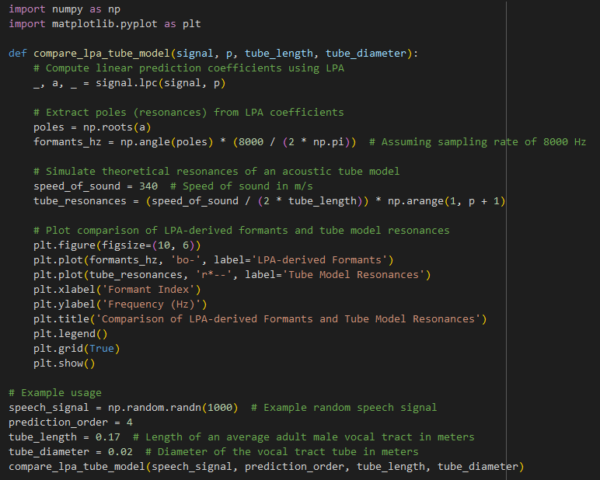
Relation of LPA to Lossless Tube Models
Practical Assignment

Slide 35
Relation of LPA to Lossless Tube Models
Summary
Linear Predictive Analysis (LPA) and acoustic tube models aim to characterize speech signals' spectral properties by identifying resonant frequencies.
The prediction coefficients (poles) derived from LPA can be interpreted as formants in an equivalent acoustic tube model, providing a physical interpretation of speech production.
Understanding the relationship between LPA and tube models offers insights into the acoustic properties of the vocal tract and aids in speech analysis and synthesis tasks.

Slide 36
Q & A

